Slide 1
Day 1

Slide 2
Evolution of HPC

Slide 3
Evolution of HPC System
Memory
Memory
Memory
Memory
…….
CPU
CPU
CPU
CPU
CPU
NETWORK
Sequential program
Mega Flops
Shared Memory
Giga Flops
Parallel programs using OpenMP and MPI
Multiple nodes
Tera Flops
Infiniband (200Gbps)
Distributed memory

Slide 4
Architecture innovations
Architecture innovations
Width: 8 bit to 16 bit to 64 bit
Multicore: single processor to multi cores
Instructions per cycle: 4-10 cycles per instructions to 4+ instructions per cycle
Clock rate : 3MHz to 4GHz

Slide 5
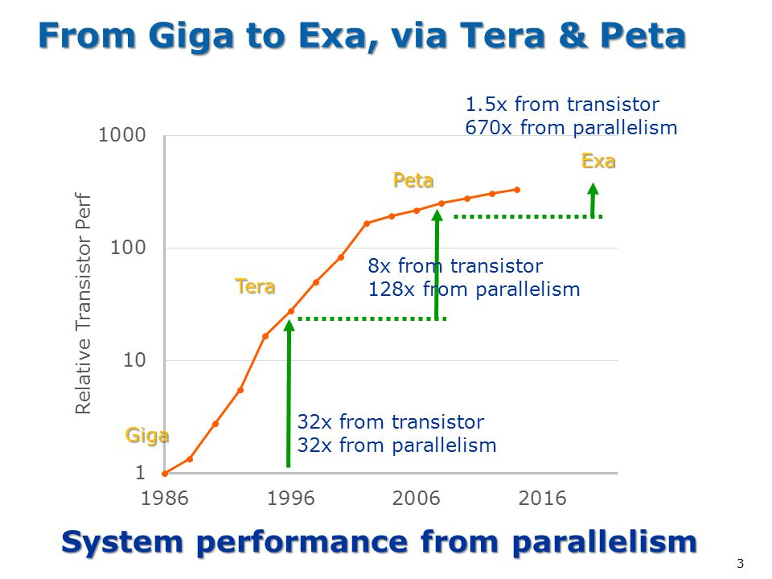
System performance from parallelism
https://www.exascaleproject.org/

Slide 6
Profiling

Slide 7
Profiling
Analyzing the behavior and performance of software applications running on HPC systems
It involves collecting detailed information about the program's execution to identify hotspots, inefficiencies, and potential areas for optimization
Ensuring efficient use of CPU, memory, I/O, and network resources

Slide 8
Profiling
Execution time of functions
Hotspots
CPU time
I/O usage
Memory utilization
Cache hits and misses
Loops
Communication patterns

Slide 9
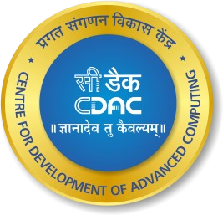
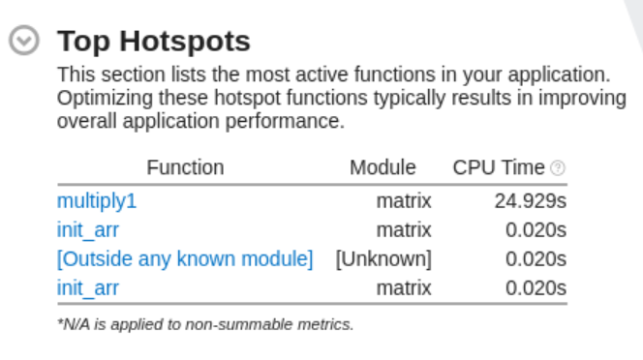
Primary goal of profiling

Slide 10
Profiling
There are two common techniques used in application profilers to collect data about the execution of an application:
Instrumentation
Sampling

Slide 11
Instrumentation
Instrumentation is a profiling technique where additional code is inserted into a program to collect performance data as it runs.
This extra code, often added at compile time or dynamically at runtime, helps gather detailed information about the execution of specific functions, memory usage, or other aspects of the program's behavior

Slide 12
Types of instrumentation
Manual Instrumentation: Developers manually insert profiling code into the application source code. This can be highly specific but is labor-intensive and prone to human error
Automatic Instrumentation: Profiling tools automatically insert the necessary code. This can be done at various stages, such as during compilation, linking, or even at runtime. Automatic instrumentation is less error-prone and more scalable

Slide 13
How instrumentation works
Function Entry/Exit Logging: Code is inserted at the entry and exit points of functions to log when they start and finish
Event Logging: Specific events (e.g., memory allocations, I/O operations) are logged
Counters and Timers: Code to count occurrences of specific events or measure the time spent in functions or code blocks

Slide 14
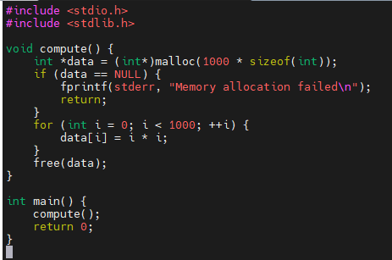
Example

Slide 15
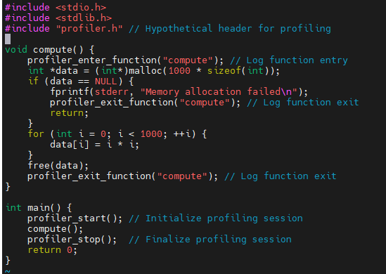
Example

Slide 16
Sampling
Sampling in profiling is a technique used to gather performance data by periodically recording the state of a program during its execution
Unlike instrumentation, which inserts additional code into the application to collect detailed metrics, sampling captures snapshots of the program's state at regular intervals

